Slide 1
Board of supervisors pay increases & Cost of living adjustments
Monica fugitt, director of support services
May 7, 2024

Slide 2
BOS PAY history
SEPTEMBER 24, 2000 Ordinance 495-17 Eliminated Biweekly $250 Vehicle Allowance & Biweekly $100 Business Expense Allowance
DECEMBER 29, 2002 Last Cost of Living Adjustment for Supervisors - 4%
MARCH 28, 2010 2% Decrease for Supervisors
OCTOBER 31, 2023 Proposed Pay Increase and Cost of Living Adjustment Fails

Slide 3
COST OF LIVING ADJUSTMENT (Cola) HISTORY
BOS
UPEC
MGMT
12/29/02 - CURRENT
12/28/03 – CURRENT
1/11/04 - CURRENT
+ 4% COLA RECEIVED 12/29/02
-2% DECREASE 3/28/2010
TOTAL INCREASE: 2%
ANNUAL COLAS RANGING 2-4%
EXCL 2009-2013
TOTAL OF 47% IN ANNUAL COLAS
COMPOUNDED TOTAL INCREASE: 58.9%
ANNUAL COLAS RANGING 2-4%
EXCL 2009-2012
TOTAL OF 53.5% IN ANNUAL COLAS
COMPOUNDED TOTAL INCREASE: 69.3%
note: 2003-2024 COLAS FOR OTHER UNITS VARY BUT ARE ON AVERAGE 55% TOTAL
This does NOT TAKE INTO ACCOUNT EQUITY ADJUSTMENTS

Slide 4
Consumer price index change
CALIFORNIA
Urban Wage Earners & Clerical Workers
February 2003 – February 2024

Slide 5
Salary study
Standard recommendation:
Shasta County salary set at the average of the comparable and contiguous agencies.
TYPICAL process
Using standard list of agencies, survey other Counties regarding position compensation using:
Salary Schedules
Job Classifications
Info from HR Departments
Record the monthly and annual salaries for each County
Review classification to ensure appropriate position is being used for comparison.
Review for other special compensation and/or stipends which may need to be considered.
recommendation

Slide 6
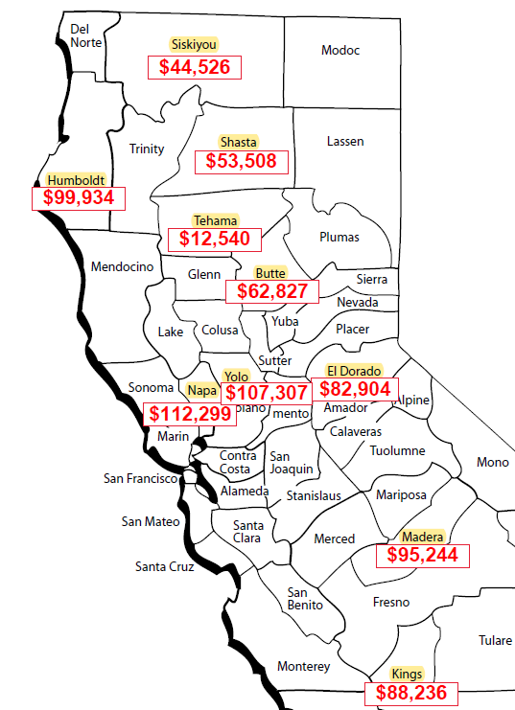
Comparable & Contiguous counties
COUNTIES
Contiguous: Counties Surrounding Shasta County Which are in Close Proximity
Comparable: Counties Which May Not Have a Close Proximity But Have Similarities in Size and/or Structure to Shasta County
BUTTE
EL DORADO
HUMBOLDT
KINGS
MADERA
NAPA
SISKIYOU
TEHAMA
YOLO
BUTTE
EL DORADO
HUMBOLDT
KINGS
MADERA
NAPA
SISKIYOU
TEHAMA
YOLO
AVERAGE OF COMPARABLE & CONTIGUOUS AGENCIES: $78,420 ANNUAL

Slide 7
AGENCY | MONTHLY | ANNUAL
TEHAMA | $ 1,045 | $ 12,540
SISKIYOU | $ 3,711 | $ 44,526
SHASTA | $ 4,459 | $ 53,508
BUTTE | $ 5,236 | $ 62,827
EL DORADO | $ 6,909 | $ 82,904
KINGS | $ 7,353 | $ 88,236
MADERA | $ 7,937 | $ 95,244
HUMBOLDT | $ 8,328 | $ 99,934
YOLO | $ 8,942 | $ 107,307
NAPA | $ 9,358 | $ 112,299
AVERAGE | $ 6,535 | $ 78,420
CURRENT
RECOMMENDATION

Slide 8
SALARIES ACROSS THE STATE OF CALIFORNIA
MORE DENSELY POPULATED/URBAN AREAS HAVE HIGHER BOARD SALARIES
AVERAGE ACROSS THE STATE: $106,329 ANNUAL
AVERAGE FOR AGENCIES W/POPULATION 100-300K: $96,704 ANNUAL

Slide 9
How did we get here?
No cost of living adjustments or increases for Board members in over 20 years.
Rising inflation
Other employee groups have received increases totaling over 50%
Establishing BOS wages at an appropriate rate of pay now requires a substantial pay increase.

Slide 10
options bos current salary: $53,508 annual
recommendation
Increase by 58.9% to mirror UPEC General: $85,024 annual
Increase by 78.2%, consistent w/CPI: $95,351 annual
Increase by 98.7% to meet CA average: $106,329 annual
Increase by 80.7% to meet average of CA Counties with population between 100-300K: $96,704 annual
Increase by 46.6% in accordance with salary study to $78,420 annual
Consistent with other equity increases, increase as recommended by salary study
Increase by 46.6%, to $78,420 annual
Add $5,000 annual vehicle allowance, paid biweekly, to cover travel expenses.
To avoid future pay disparity, approve future cost of living adjustments for Supervisors, to be received at the same times and amounts as UPEC-General
Implement 1% CalPERS cost share of employer contribution, consistent with other represented groups

Slide 11
Fiscal impact
Estimated Salary and Benefit Increase:
$200,000 Annual General Fund Impact
If approved, changes will be effective July 14, 2024
Future Budgets will be adjusted as appropriate to account for any known COLAs.

Slide 12
Questions?

