Slide 1
Auditor-Controller’s Office
The Auditor-Controller is the chief financial officer of the County. The Auditor-Controller performs duties under the legal authority prescribed in the California Government Code. The Auditor-Controller is an elected official that is responsible for providing a broad range of financial accounting and auditing services to all County departments, agencies, and various special districts within the County of Shasta whose funds are kept in the county treasury.
Mission Statement
The Auditor-Controller Department is committed to working with integrity and professionalism to provide the citizens, the other county departments, and the agencies of Shasta County with accurate and timely financial reports and services.
Duties of the Office
The Auditor-Controller is responsible for assuring the appropriateness of County expenditures prior to payment of claims; processing the countywide payroll; performs tax accounting functions and assessment roll changes; tabulates the County budget and maintains budgetary controls; prepares the County Cost Plan in accordance with State and Federal Requirements; prepares various financial reports required by the County, State, and Federal authorities; and performs internal audits.

Slide 2
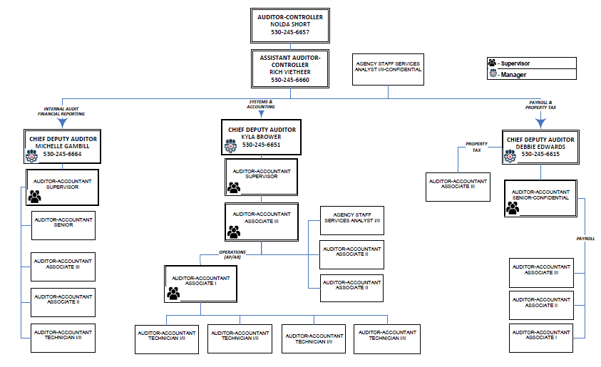
Auditor-Controller Org Chart

Slide 3
Internal Audit & Financial Reporting Unit
INTERNAL AUDIT AND FINANCIAL REPORTING (6 STAFF, INCLUDES 1 WORKING MANAGER)
MAJOR FUNCTIONS
Complete various financial statements (County ACFR, TDA, AQMD, SJPFA, single audit, citizen's report)
Prepare and submit the Countywide Cost Allocation Plan
State Controller Financial Transactions Report (FTRs) annually
Submit SB90 claims for all county departments annually
Budgets (budget schedules, fund balance worksheets, upload budget files, amendments, etc.)
Calculate the appropriations limit
JE audits (5,155 FY 22/23)
TOT Audit program contract with Treasurer
Audits of cash and cash equivalents throughout the county
Retention audits
Grant audits
Compilation and presentation of county fees
Various internal audits upon request
Various year end processes to close the books
Monthly and annual reconciliations of various accounts countywide
Evaluations and other employee related functions
Whistleblower and fraud investigations
TC-31 reconciliation and filing of state reports monthly
Process monthly agency payments to agencies not in the county treasury
Administer long term debt for county agencies
Productive hourly rates and ICRP calculations/review
Public safety MOE
Realignment deposits and distribution Monthly
Cash over/short and relief of accountability processes
Create and update auditor policies and procedures for all accounting functions
Review and implement any changes to laws
Capital asset reconciliations and annual inventory process
Establish and maintain funds/accounts (261 county funds, 288 school funds, 4538 active accounts)
Monthly interest apportionment
Training, training, training for all fiscal staff countywide
Public information requests
Other duties as assigned

Slide 4
Auditor-Controller Org Chart

Slide 5
Accounting & Finance System Unit
Including Card & Epayable Admin
SYSTEM AND ACCOUNTING
GENERAL ACCOUNTING & FINANCE SYSTEM ADMIN (4.5 STAFF, INCLUDES ½ WORKING MANAGER)
MAJOR FUNCTIONS
Reconcile various accounts at month end (prepaids, receivables, etc.).
Bi-weekly new user finance system training (countywide)
Administer system security (countywide)
System development, testing and implementation
Yearend accruals
Audit and issue 1099's
Quarterly and annual non-resident withholding reporting
Lobbyist reporting
Sales & Use Tax monthly/quarterly reconciliation, reporting and remittance
CA E-Waste annual reconciliation, reporting and remittance
Year-end encumbrance reconciliations
Stale dated and bad check processes
Daily cash balancing
Employee stats and check run reports
Create or update user guides for all finance system functions
Review and implement any changes to law
Contract and PO audit and encumbrances
Evaluations and other employee related functions
Ongoing training and education to county departments, schools, special districts
Public information requests
Other duties as assigned
CARD AND EPAYABLES ADMINSTRATION (1/2 STAFF)
MAJOR FUNCTIONS
• Administer and issue CalCards and fuel cards countywide
• CalCard and Fuel Card new user training countywide
• CalCard and Fuel Card payments and reconciliations
• Administration and reconciliation of the EPayables program

Slide 6
Auditor-Controller Org Chart

Slide 7
GL Posting/System Integrity Unit
SYSTEM AND ACCOUNTING
GL POSTING AND SYSTEM INTEGRITY (1 STAFF)
MAJOR FUNCTIONS
Posting of ALL finance system transactions for county, schools, and special districts
Invoices, deposit, JE’s, budget amendments, check runs, cash reports, interfaces, wire transfers, etc.
Process the daily check run
Data entry when needed
Vendor database administration
Ensure integrity of double entry accounting system by logging every transaction posted and balancing to finance system
Other duties as assigned

Slide 8
Auditor-Controller Org Chart

Slide 9
Accounts Payable/Accounts Receivable Unit
SYSTEM AND ACCOUNTING
AP/AR/CLAIMS AUDIT (5 STAFF, INCLUDES ½ WORKING MANAGER)
MAJOR FUNCTIONS
Audit invoices (66,820 FY 22/23)
Audit deposits (8,908 FY 22/23)
Audit CalCard transactions
Process wire transfers
Audit check batches for schools/college/CalSAWS
Assist schools and special districts
ACH administration
Ongoing training and education to county departments, schools, special districts
Public information requests
Other duties as assigned

Slide 10
Auditor-Controller Org Chart

Slide 11
Property Tax Unit
PAYROLL AND PROPERTY TAX
PROPERTY TAX (1.5 STAFF INCLUDES ½ WORKING MANAGER)
MAJOR FUNCTIONS
Setup new tax year and calculate the tax rates each year
Secured and unsecured extensions
Process taxroll changes (5,455 FY 23/24 so far)
Complete ERAF calculations to redistribute taxes to schools
Complete RDA calculations to redistribute taxes to redevelopment agencies
Place direct charges on the tax bills from various agencies (193 separate tax levies, 156,640 special assessment charges FY 23/24)
Calculate debt rates for all voter approved debt
Distribute/apportion taxes collected by the tax collector
Issue refunds monthly
Various state reporting (homeowners, RPTTF, J29, BOE822, etc.)
Administer long term debt for schools and special districts on the tax roll
Calculate and bill property tax admin fees
Process payments to pay tax bills for all county owned property
Annual tax sale and tax loss reserve adjustments
Reconcile and keep balanced all funds related to property tax
Jurisdictional changes/TRA consolidations
Review and implement any changes to law
Apportion tax deposits received from other counties
Annual Teeter buyout process
Evaluations and other employee related functions for auditor staff
Training, training, training for agencies receiving funds through the property tax system
Public information requests
Individual taxpayer assistance as needed
Other duties as assigned

Slide 12
Auditor-Controller Org Chart

Slide 13
Payroll Unit
PAYROLL AND PROPERTY TAX
PAYROLL (4.5 STAFF INCLUDES ½ WORKING MANAGER)
MAJOR FUNCTIONS
Timecard audit for 14 different bargaining groups/MOUs (53,277 timecards FY 22/23)
Bi-weekly payroll processing and posting (2,240 Full Time equivalents FY 22/23)
Benefits administration for actives and retirees (4,879 FY 22/23)
Dental, vision, health, 457, 401a, flex spending accounts, etc.
Bi-weekly CalPERS reporting
Process vendor payments generated from payroll for benefits, state/fed deposits, etc.
Monthly, quarterly, and annual reporting 941, W2, EDD, etc.
Retirement calculations and term projections
Coordination of SDI or Leave of absence for employees on leave
Evaluations and other employee related functions
Employee certification of wages
Implement and test all negotiated changes or updated laws in the finance system
Collections, garnishments, and liens
Payroll accruals
Retroactive payment calculations
Maintain retiree receivable system and process monthly retiree benefit disbursements
Various other calculations, working out of class pay, individualized contracts, etc.
Engage in various required audits (CalPERS, Teamsters, IRS, etc.)
Individual employee and retiree assistance as needed
Evaluations and other employee related functions for auditor staff
Training, training, training for all fiscal staff and employees countywide
Public information requests
Other duties as assigned

Slide 14
Auditor-Controller Org Chart

Slide 15
Administration
ADMINISTRATION (3 STAFF, INCLUDES 2 WORKING MANAGERS)
ADMIN (1 STAFF – 50% SERVES AUDITOR’S OFFICE FUNCTIONS, 50% WORKS IN OTHER AREAS)
MAJOR FUNCTIONS
Print, stuff, and mail countywide checks (CIV, Payroll, and AP)
Process returned checks and reversals countywide
Answer phones
Manage the front desk, including check pickups
Maintain personnel files for Auditor staff
Enters CHPs and PAFs for Auditor employees
Month end reconciliation for all accounts in the Auditor cost center
Purchasing for Auditor's office
Enter invoices, deposits, CalCard transactions, and journals for Auditor's office business
Distribute various documents to departments, vendors, public, staff
Other administrative functions
Serves as department safety coordinator
DEPARTMENT HEAD/ASSISTANT DH (2 WORKING MANAGERS - APPROX 70% DIRECT TIME AND 30% INDIRECT)
MAJOR FUNCTIONS
Board meetings
Review and approval all OneMeeting items countywide
Public information requests
Review and approval of all high-level audit documents leaving the office
Attend special district meetings
Manage the office
Work in all areas of the office as needed, depending on time of year/staffing
Provide assistance and support to departments, including monthly recap meetings
Whistleblower investigations
Evaluations and other employee related functions for auditor staff
Presentations and trainings
Employee negotiations
Annual budget processes
Evaluations and other employee related functions
Ongoing training and education to county departments, schools, special districts
Other duties as needed

Slide 16
Other
EXTRA HELP STAFF (2 PART TIME STAFF – 10 hours each)
Filing, sorting, copying, shredding, labeling and any other support function we can prevent paying higher level staff to perform

Slide 17
Questions?
Please feel free to contact us anytime with questions
Nolda Short nshort@shastacounty.gov 530-245-6657
Richard Vietheer rvietheer@shastacounty.gov 530-245-6660

